Slide 1
The Fellowship of the Ring Personal Leadership Towards Joyful Work
With Joe Schmetzer & Portia Tung

Slide 2
The Dream
Suppose tonight, while you slept, a miracle occurred.
When you awake tomorrow, what would be some of the things you would notice that would tell you that you're doing more joyful work?
Notes:
Take a couple of minutes.
In pairs, take turns sharing your miracle and notes for one another.

Slide 3
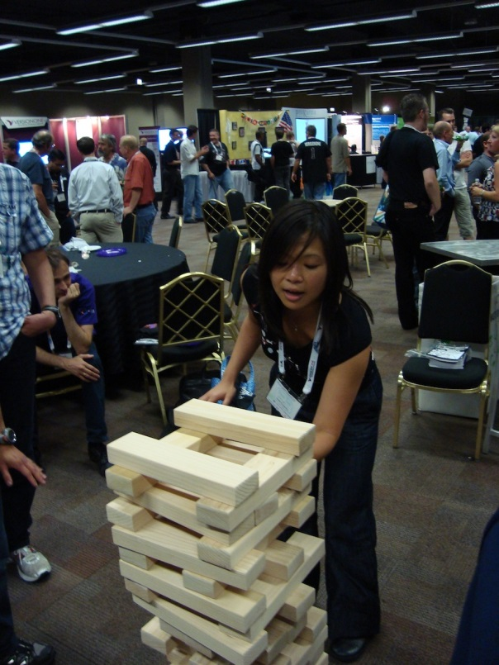
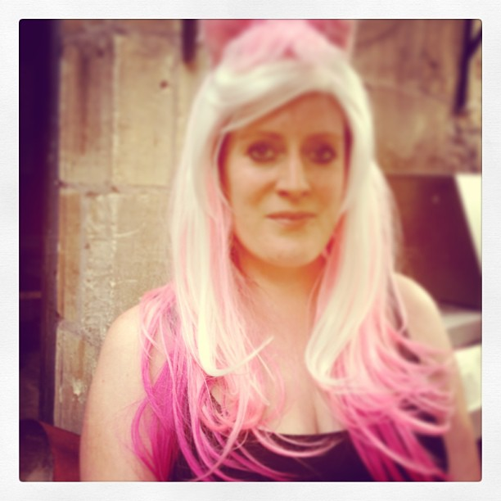
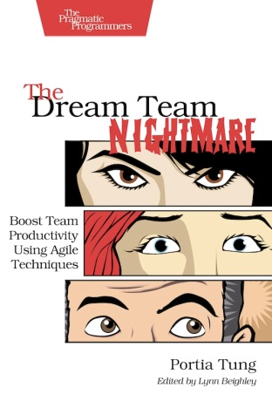
About Us
Joe Schmetzer
Portia Tung
Renaissance Developer Generalising specialist Coach
Agile Coach Playmaker
Enterprise Gardener
Twitter: tumbarumba
Blog: www.selfishprogramming.org
Twitter: portiatung

Slide 4
In search of joyful work
To do joyful work
As aspiring leaders
We need to practice personal leadership.
Success Criteria
[ ] I know what the Mutual Learning Model is
[ ] I know what the 8 behaviours are
[ ] I've a deeper understanding of the way I lead
[ ] I've identified at least one personal improvement action
[ ] We've had fun!

Slide 5
The Mutual Learning Scale
1 = Definitely false 2 = Mostly false 3 = Mostly true 4 = Definitely true
__ 1) I have information and others do, too.
__ 2) Each of us sees things others don't.
__ 3) People may disagree with me but still have pure motives.
__ 4) Differences are opportunities for learning.
__ 5) It's possible I may be part of the problem.
__ 6) I state views and ask genuine questions.
__ 7) I share all relevant information.
__ 8) I use specific examples and agree on what important words mean.
__ 9) I explain my reasoning and intent.
__ 10) I focus on interests not positions.
__ 11) I test assumptions and inferences.
__ 12) I jointly design next steps.
__ 13) I discuss undiscussable issues.
Scale design by Portia Tung & Joe Schmetzer
Derived from Chris Argyris’s Mutual Learning Model and “Smart Leaders Smarter Teams” by Roger Schwarz
Notes:
This is the Mutual Learning Scale.
Next to each numbered statement, note down either 1, 2, 3, 4 depending on how true each statement applies to you.
When you’ve completed the scale, raise your hand to help us pace the exercise.
[Everyone or majority of people has raised their hand]
Now it’s time for a bit of mental arithmetic.
First, add up your ratings for all 13 statements.
Next, add up your ratings for the first 5 statements.
Last, add up your ratings for the remaining 8 statements.
Keep the 3 numbers safe. We’re going to come back to them shortly.

Slide 6
Prologue
A release must be ready for next week's trade show.
Three key players are meeting to discuss the progress of the release.
Notes:
Give out large wearable nameplates to actors.
Give Values and Assumptions to actors.
Give Behaviours sheet to audience members.
Get observations on results from audience members.

Slide 7
Act I Scene I
The weekly project progress meeting.
Enter the product owner, project manager and team lead.
Notes:
Hand out large wearable nameplates for actors.
Give Model 1 Values and Assumptions cue cards to actors.
Give Model 1 Behaviours bingo sheet to audience members.

Slide 8
Reflection
What did you see and hear?
What were the goals of each character?
Who has been to a meeting like this?

Slide 9
Theory
Introduce Model 1:
Reveal Values & Assumptions
Reveal Behaviours
Recap on Results

Slide 10
Act II Scene I
The weekly project progress meeting.
Enter the product owner, project manager and team lead.
Notes:
Hand out large wearable nameplates for actors.
Give Model 2 Values and Assumptions cue cards to actors.
Give Model 2 Behaviours bingo sheet to audience members.

Slide 11
Reflection
What did you see and hear?
What were the goals of each character?
Who has been to a meeting like this?
Who wants their meetings to be more like this?

Slide 12
Theory
Introduce Model 2:
Reveal Values & Assumptions
Reveal Behaviours
Recap on Results

Slide 13
Theory in Depth
Chris Argyris's Model 1 + Model 2
Plus Schwarz's 8 Behaviours for Smarter Teams
Notes:
Combine Chris Argyris's Model 1: Unilateral Control vs Model 2: Mutual Learning Model
- What people say they think – espoused theory
- What people are observed doing – theory in use
- Observable behaviour reveals discrepancy between espoused theory and theory in use
With Schwarz's 8 Behaviours for Smarter Teams
- If you learn and practice these behaviours (aka skills), your theory in use can transition from Model 1 to Model 2.
- Fundamentally, it's important to change your mindset in order to change behaviour to have long-term results.
The Metaphor:
Your mindset = Operating system (Windows)
Your behaviours = Application software (eg Word)

Slide 14
What’s your leadership preference?
32
competent
Weak Mutual Learning mindset; rarely applies it
Applies Mutual Learning behaviours most of the time
24
x
x
advanced beginner
Congruent in mindset and behaviour most of the time
Regularly gets desired results from Virtuous Mutual Learning cycle
16
x
Claims to have strong Mutual Learning mindset
Rarely apply behaviours in practice
B e h a v i o u r
novice
8
100 % UC
0
5
10
15
20
M i n d s e t
Hypothetical results mapping by Portia Tung & Joe Schmetzer
Notes:
Hypothesis can be proven by comparing expected results from Virtual Cycle of Mutual Learning.
About the Mutual Learning Scale:
The first 5 statements are the assumptions from Chris Argyris’s Mutual Learning Mindset
The next 8 statements are the behaviours from Schwarz.
How does the scoring work?
Score for assumptions range from:
5 = Don’t apply values
10 = Rarely apply values
15 = Mostly apply values
20 = Always apply values
Score for behaviours range from:
8 = Don’t apply behaviours
16 = Rarely apply behaviours
24 = Mostly apply behaviours
32 = Always apply behaviours
Maximum congruence scores:
13 = 100% UC
26 = Mostly UC
39 = Mostly ML
52 = 100% ML
So how did you score on the Mutual Learning Scale?
If you scored a total of 52 points, stand up. This is the highest possible score on the scale and means you’re congruent in your espoused theory and theory in practice.
You believe in your ML talk AND you talk the talk and walk the walk all the time.
If you scored between 26 - 39 points, stand up. This means you apply Mutual Learning sometimes to often.
You believe somewhat in your ML talk AND you can talk the talk and do walk the walk all the time.
If you scored 26 points or lower, stand up. This means you Unilateral Control is most likely to be your default way of working.
You believe in your UC talk AND you talk the talk and walk the walk all the time.
So – why did I ask you to share your score?
The main reason is to create the option for you to find the practitioners of ML during the break and get tips on how to live and breathe the Mutual Learning Model and 8 behaviours, even under stress.
Thank you. Everyone take a sit.
Let’s look at the findings in greater detail. If you scored 15 for mindset and 24 for behaviour, it means you are congruent in applying Mutual learning most of the time. The results you get from your efforts should reflect this.
On the one hand, if you scored higher in behaviour than mindset, it means you actively apply the Mutual Learning behaviours without really applying the mindset. You believe in your talk AND you talk the talk and walk the walk.
On the other hand, if you scored higher in mindset than behaviour, it means that you believe strongly in the Mutual Learning mindset yet rarely apply the behaviours in practice. This puts into question how much you really value the mindset and/or understand it. You believe in your talk BUT you only talk the talk and don’t walk the walk.

Slide 15
Your Turn
In pairs:
Share your thoughts on the concepts
Discuss insights
Identify at least one personal improvement action in the way you lead

Slide 16
Summary
Applied the Mutual Learning Scale to ourselves
Learned about the Mutual Learning Model
Learned about the 8 behaviours
Identified ways we can apply the concepts

Slide 17
Recommended Resources
London Action Science Meetup Group
http://www.meetup.com/London-Action-Science-Meetup/
Eight Behaviours for Smarter Teams (free download):
http://www.schwarzassociates.com/resources/articles/
Smart Leaders Smarter Teams by Roger Schwarz
More about Action Science:
http://www.actionscience.com/actinq.htm
Amy Cuddy's Power Pose Ted talk
https://www.ted.com/talks/amy_cuddy_your_body_language_shapes_who_you_are

Slide 18
In search of joyful work
To do joyful work
As aspiring leaders
We need to practice personal leadership.
Success Criteria
[ ] I know what the Mutual Learning Model is
[ ] I know what the 8 behaviours are
[ ] I've a deeper understanding of the way I lead
[ ] I've identified at least one personal improvement action
[ ] We've had fun!

Slide 19
Thank you for playing!
Joe Schmetzer
Portia Tung
Renaissance Developer Generalising specialist Coach
Agile Coach Playmaker
Enterprise Gardener
Twitter: tumbarumba
Blog: www.selfishprogramming.org
Twitter: portiatung

Slide 20
Session Schedule
00.00 - 00.03 | Ice breaker and introductions and session goal and criteria
00.03 - 00.05 | Mutual Learning Self-Assessment
00.05 – 00.06 | Prologue
00.06 – 00.11 | Act I, Sc. 1
00.11 – 00.21 | Reflection
00.21 – 00.326 | Model 1 Theory
00.26 – 00.31 | Act I, Sc. 1
00.31 - 00.41 | Reflection
00.41 – 00.46 | Model 2 Theory
00.46 - 00.51 | Theory in Depth
00.51 – 00.56 | Mutual Learning Self-Assessment Results
00.56 – 00.59 | Sharing and Improvement Actions
00.59 – 00.62 | Session summary and closing

Slide 21
Appendix

Slide 22
You are the Product Owner
You told the development team a release must be ready for the trade show.
You want to win the best product award in 2016.
You have shares in the company.

Slide 23
You are the Project Manager
You expect the release to be ready for next week.
You're always right.
You're looking forward to positive recognition for this project.
Notes:
Team Lead:
The development team haven't made much progress.
You're going to miss the agreed deadline.
You don't want to tell people you're going to miss the deadline because you want to avoid confrontation.
Make large wearable nameplates for actors.
Give Values and Assumptions to actors.
Give Behaviours sheet to audience members.
Get observations on results from audience members.

Slide 24
You are the Team Lead
The development team haven't made much progress.
You're going to miss the agreed deadline.
You don't want to tell people you're going to miss the deadline because you want to avoid confrontation.

Slide 25
Product Owner
Project Manager
Team Lead
Notes:
Wearable nameplates to make and give to actors.
Why not go hands-free? Just add string so they can put it around their necks.

